Slide 1
Object Oriented Programming

Slide 2
JAVA
Object oriented
WORA
automatic garbage collector
originally developed in 1991 by James Gosling at Sun Microsystems
released in 1995 as a core component of Sun Microsystems' Java platform
Now merged into Oracle Corporation
much of its syntax from C and C++, but it has fewer low-level facilities than either of them.

Slide 3
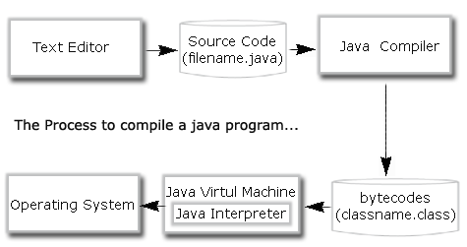
java compilation process diagram

Slide 4
Java Virtual Machine
Java was designed with a concept of
‘write once and run everywhere’.
The JVM is the environment in which Java programs execute. It is a software that is implemented on top of real hardware and operating system.
When the source code (.java files) is compiled, it is translated into byte codes and then placed into (.class) files.
The JVM executes these bytecodes.
A JVM can either interpret the bytecode one instruction at a time
The JVM must be implemented on a particular platform before compiled programs can run on that platform.

Slide 5
Integrated development environment
An integrated or interactive development environment (IDE)
is a software application
provides comprehensive facilities to computer programmers for software development.
normally consists of a source code editor, build automation tools and a debugger
Some IDEs contain a compiler, interpreter, or both, such as Net Beans and Eclipse
Some IDEs support multiple languages
Many modern IDEs also have a class browser, an object browser, and a class hierarchy diagram

Slide 6
Structure of Java Code
public class MyFirstJavaProgram {
/* This is my first java program. This will print 'Hello World' as the output */
public static void main(String []args) {
System.out.println("Hello World");
// prints Hello World
}
}

Slide 7
Object Oriented Programming
A method of implementation in which programs are organized as cooperative collection of objects, each of which represents an instance of a class, and whose classes are all members of a hierarchy of classes united via inheritance relationships.

Slide 8
principles of Object Oriented Programming are
Data hiding
Abstraction
Encapsulation
Inheritance
Polymorphism

Slide 9
Object Oriented Programming
Data hiding
Information Hiding is concealing some information
For example use of access modifiers in C++ (public, private, protected etc.) hides some data.
Encapsulation
Encapsulation is encapsulating or grouping 1 or more things (data and operations) together into a single entity.
Don’t mistake this with information hiding, all the data encapsulated need not be hidden.

Slide 10
Object Oriented Programming
Abstraction
Abstraction is a way of dealing with the information you want and ignoring the rest (as good as non-existent for you) from 1 or more items.
Inheritance
Inheritance is the process of creating new classes, called derived classes, from existing or base classes.
Polymorphism
Different forms

Slide 11
Oops others
Classes
Objects
Instance
Method
Message Parsing

